Slide 1
Computational and Image Analysis Tools in Python
Crash Course

Slide 2
Overview
Key python libraries from bootcamp
Classical Computer Vision Algorithms
Dimensional reduction using UMAP/Scikit
Unsupervised machine learning algorithms for clustering
MATLAB Machine Learning and Deep Learning Toolboxes
Synthetic data generation for preprocessing data
Imaris filament AI tool
Essential developer tools

Slide 3

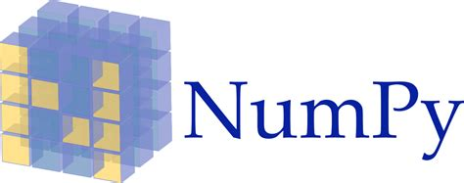

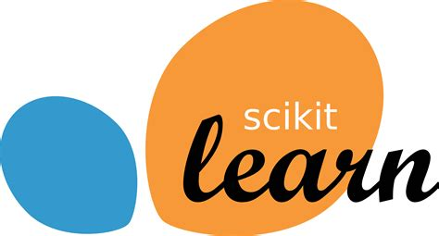
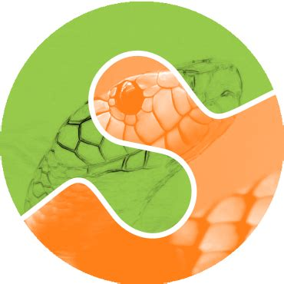
Data visualization
Computation with Arrays
Read/write files, data frames
Scikit-image
Machine learning toolbox
Image processing
All have very thorough documentation for their API on their websites, explaining all the functions and their parameters

Slide 4
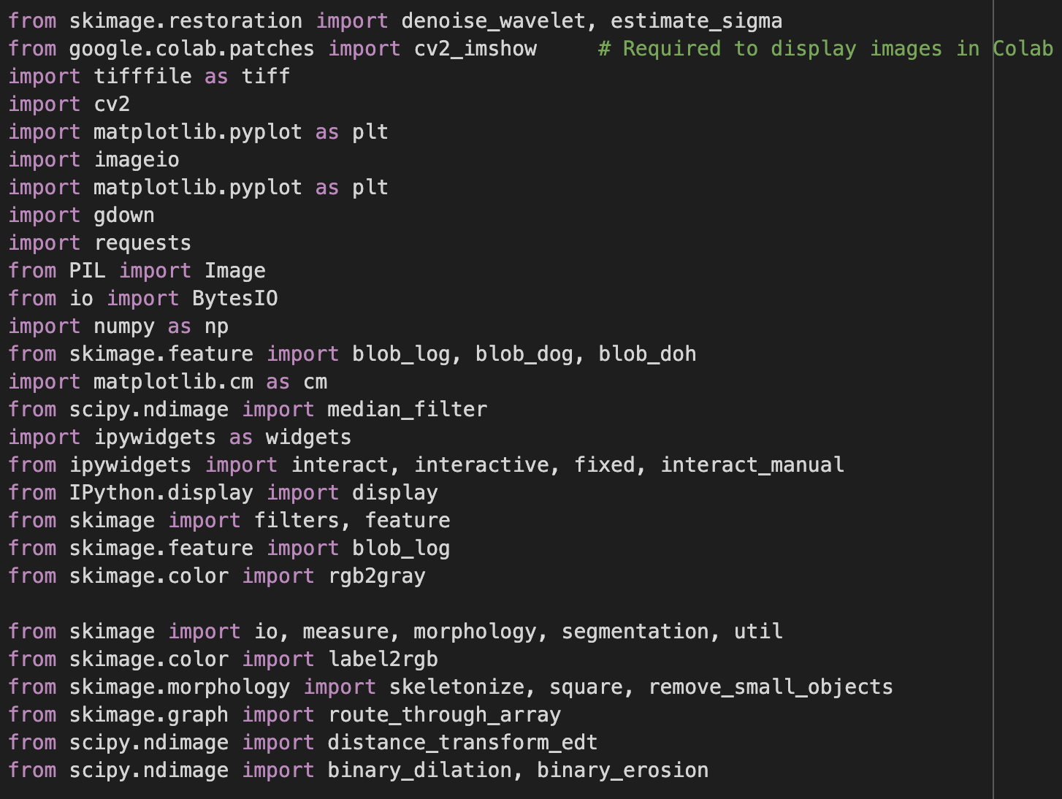
Imports

Slide 5
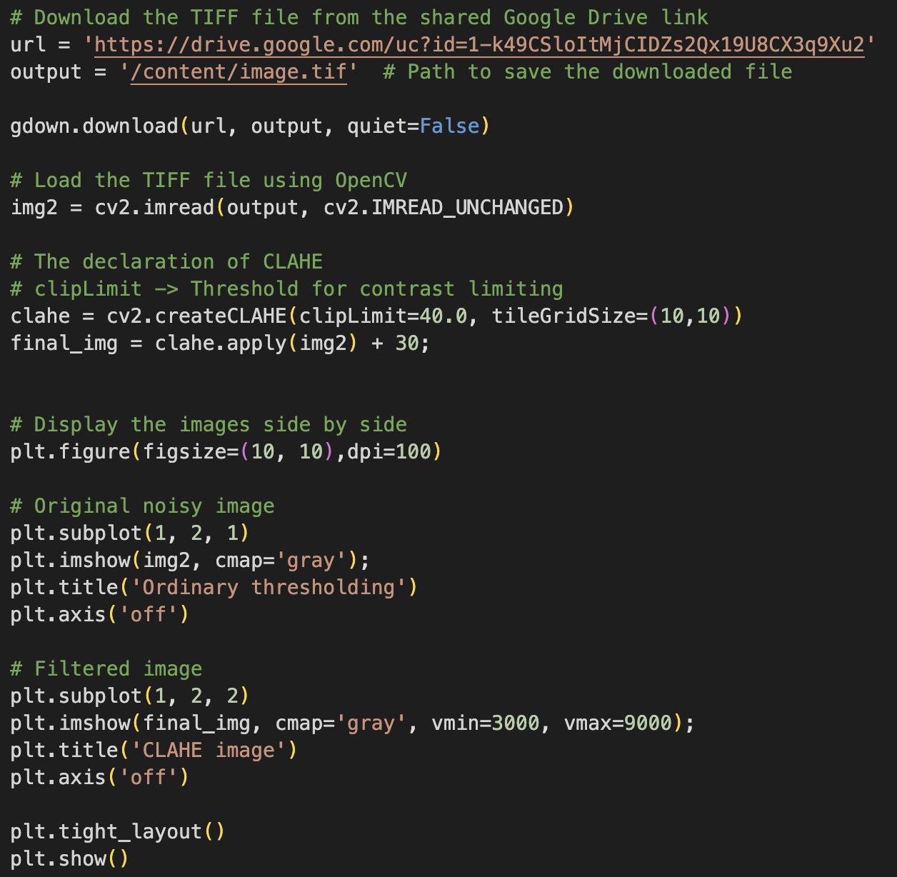
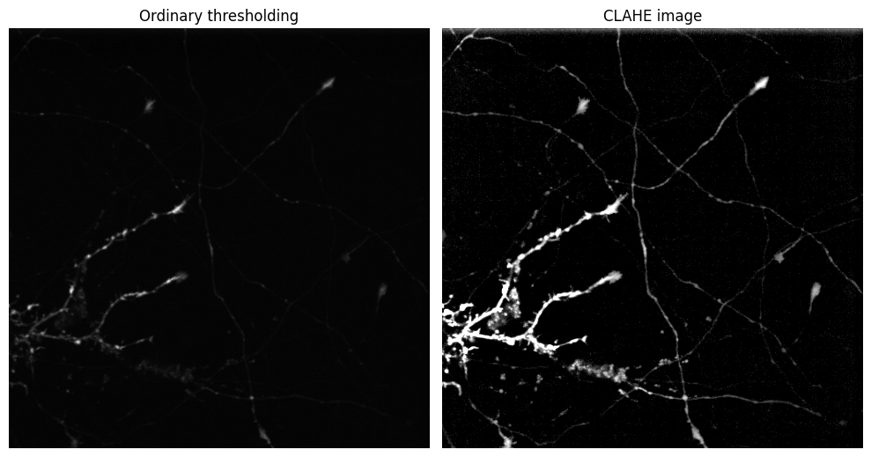
Contrast Limited Adaptive Histogram Equalization (CLAHE)
Essentially, histogram equalization works by:
a. Computing a histogram of image pixel intensities
b. Evenly spreading out and distributing the most frequent pixel values (i.e., the ones with the largest counts in the histogram)
c. Giving a linear trend to the cumulative distribution function (CDF) via brute force
The result of applying histogram equalization is an image with higher global contrast.

Slide 6
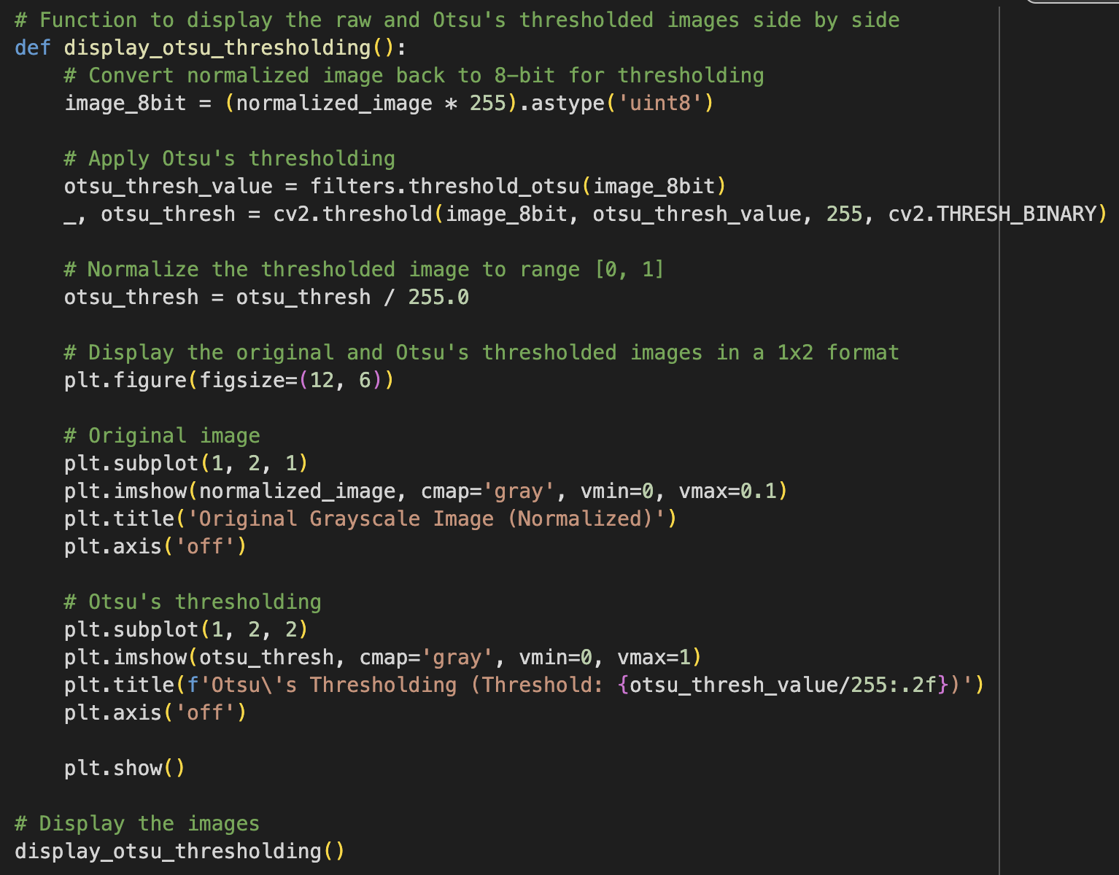
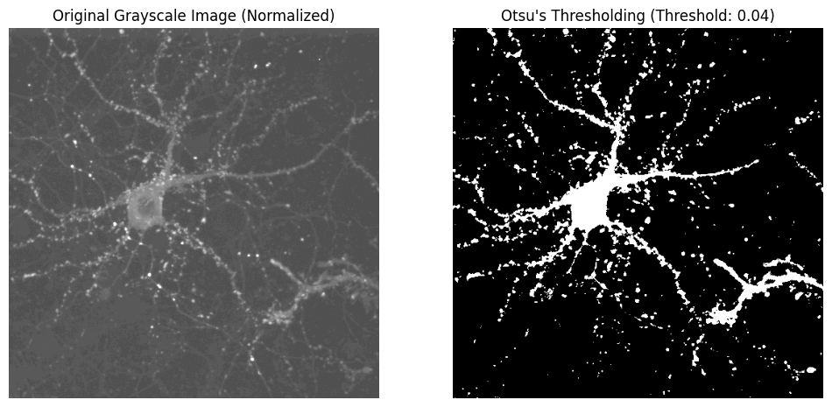
Otsu's method
The algorithm returns a single intensity threshold that separate pixels into two classes, foreground and background. This threshold is determined by minimizing intra-class intensity variance, or equivalently, by maximizing inter-class variance.

Slide 7
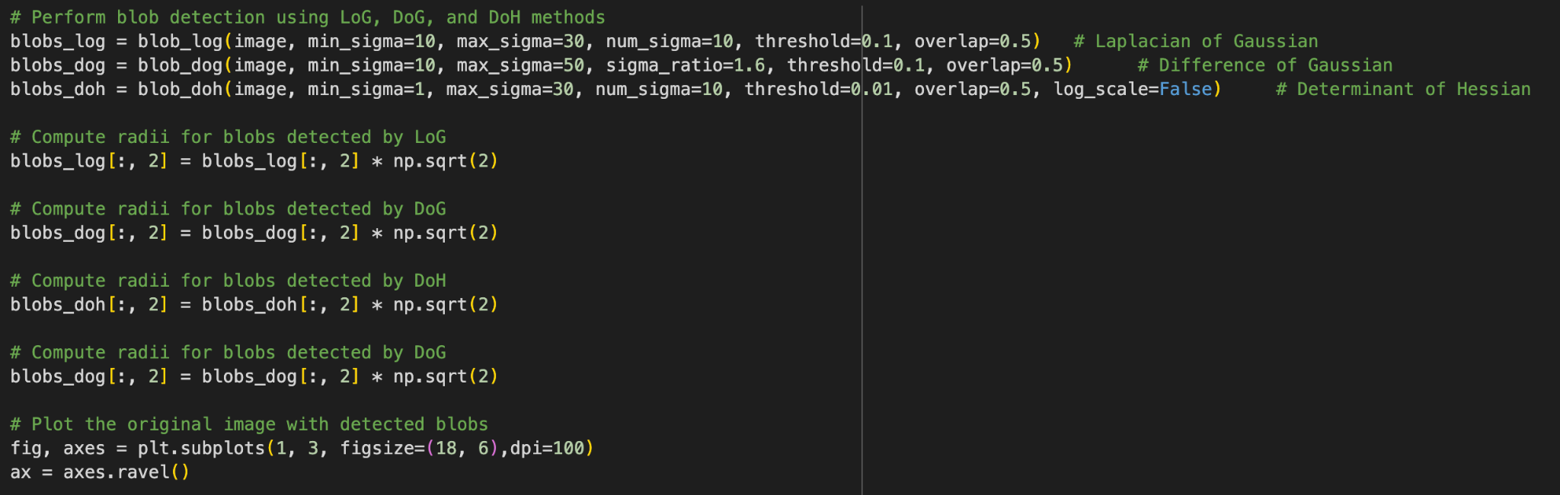
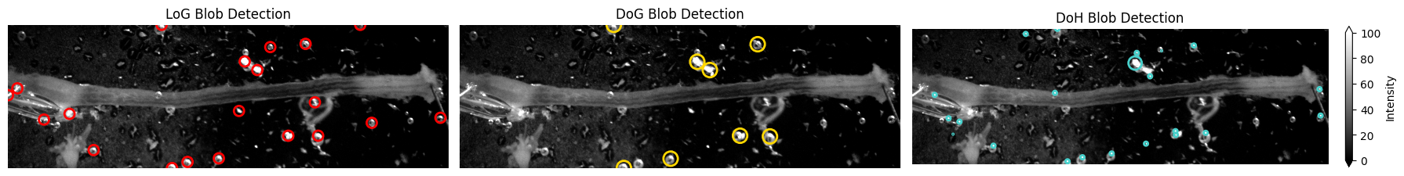
Different Blob Detection Methods:

Slide 8
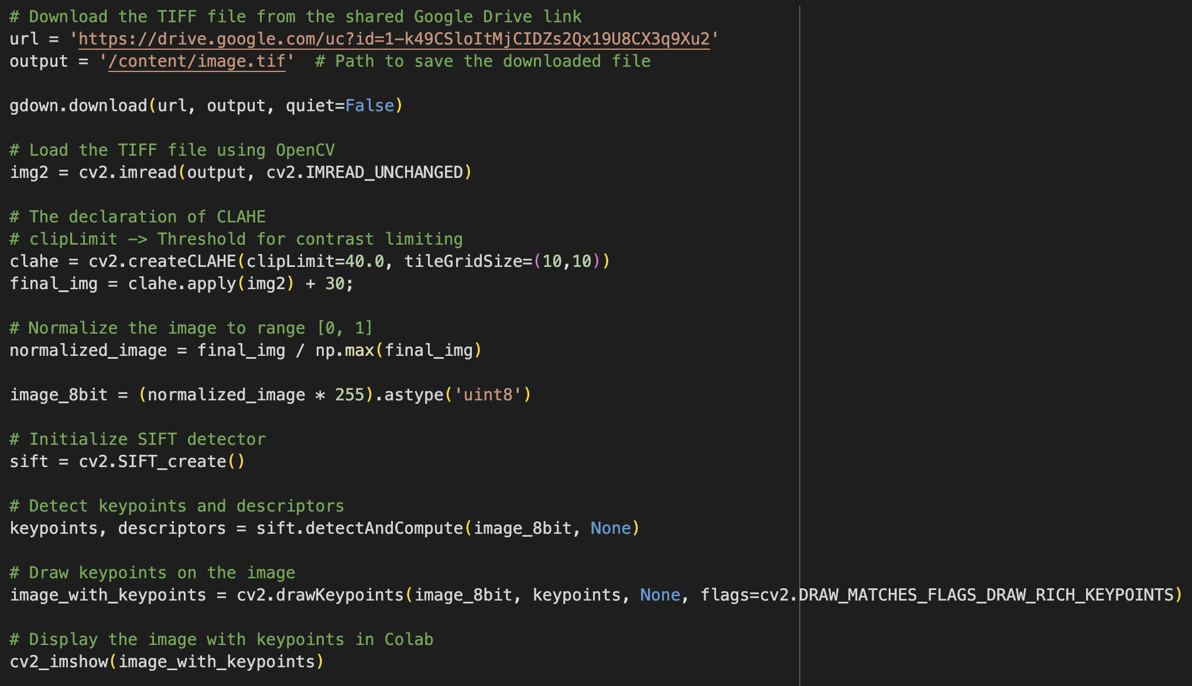
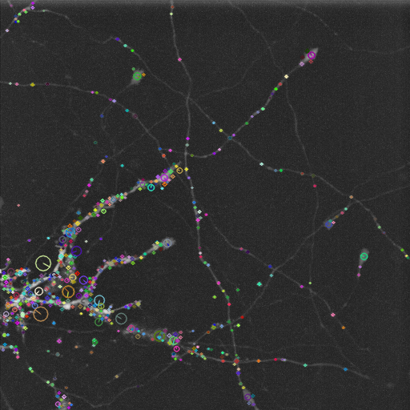
SIFT (Scale-Invariant Feature Transform):
SIFT is a widely used method for detecting and describing local features in images. It identifies keypoints in the image that are invariant to scale, rotation, and illumination changes. These descriptors are highly distinctive and robust, making them suitable for tasks like object recognition, image stitching, and 3D reconstruction.

Slide 9
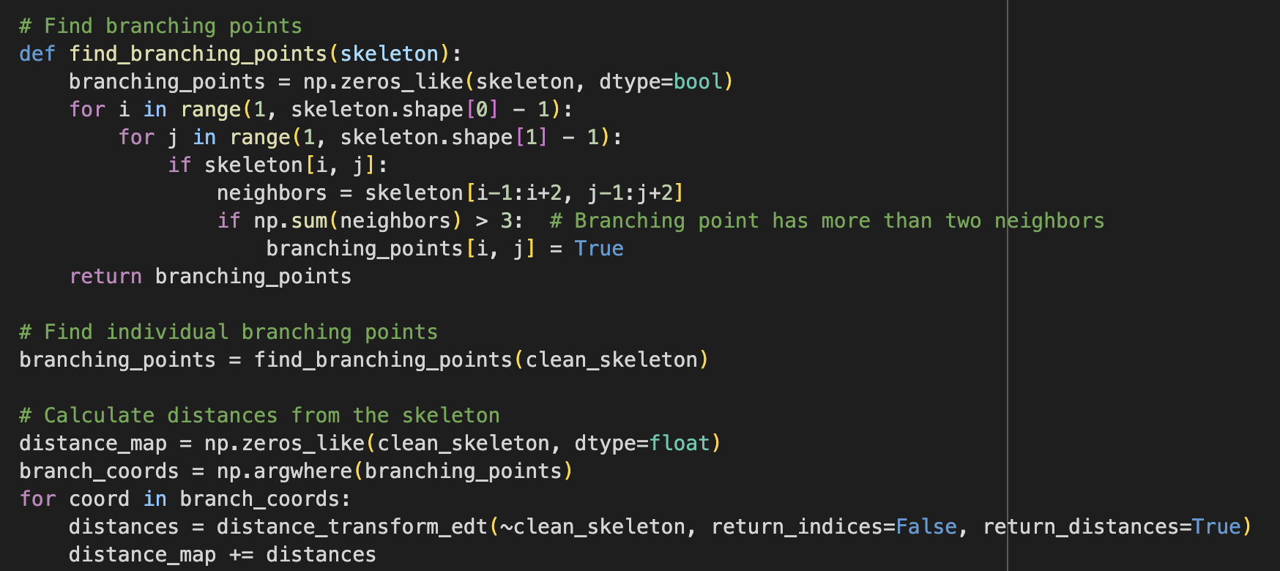
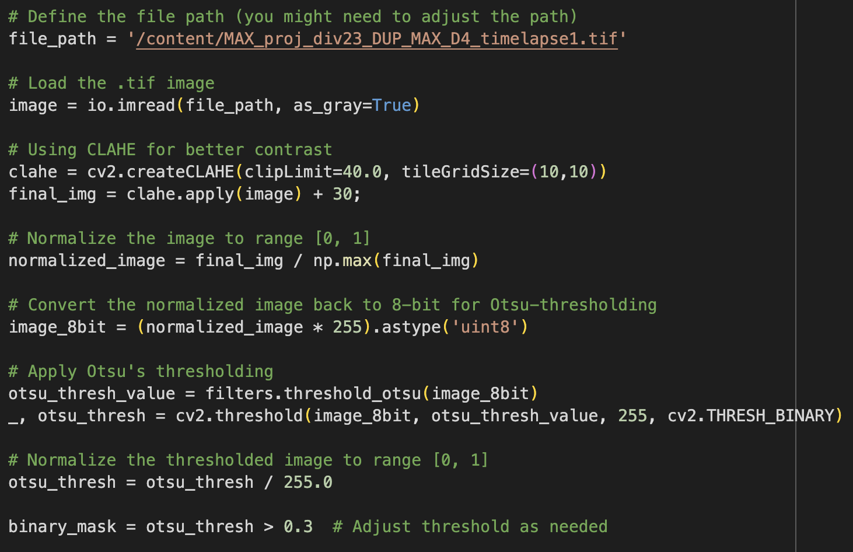
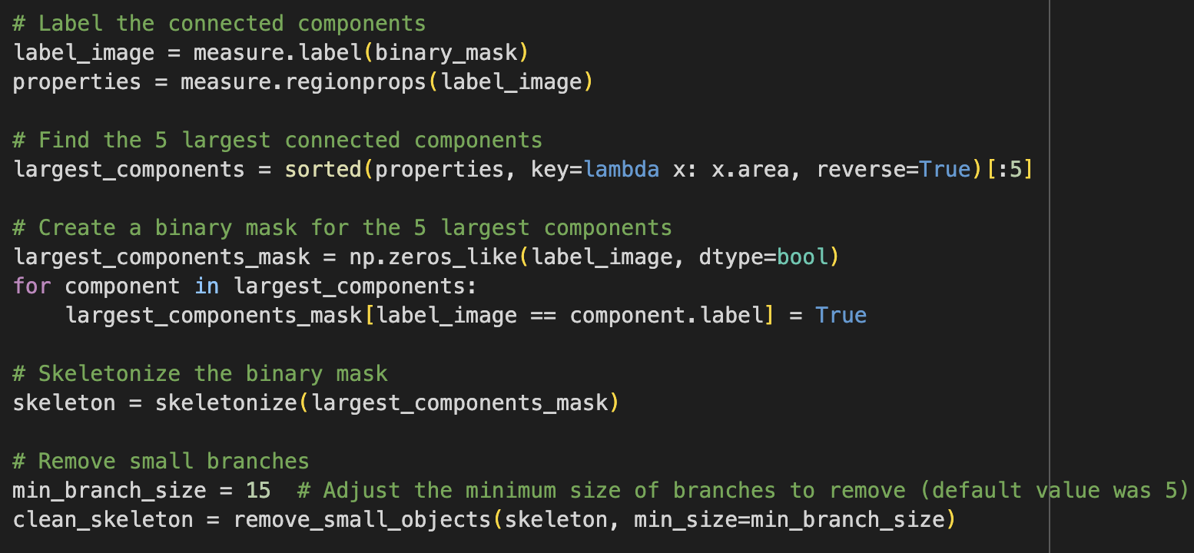
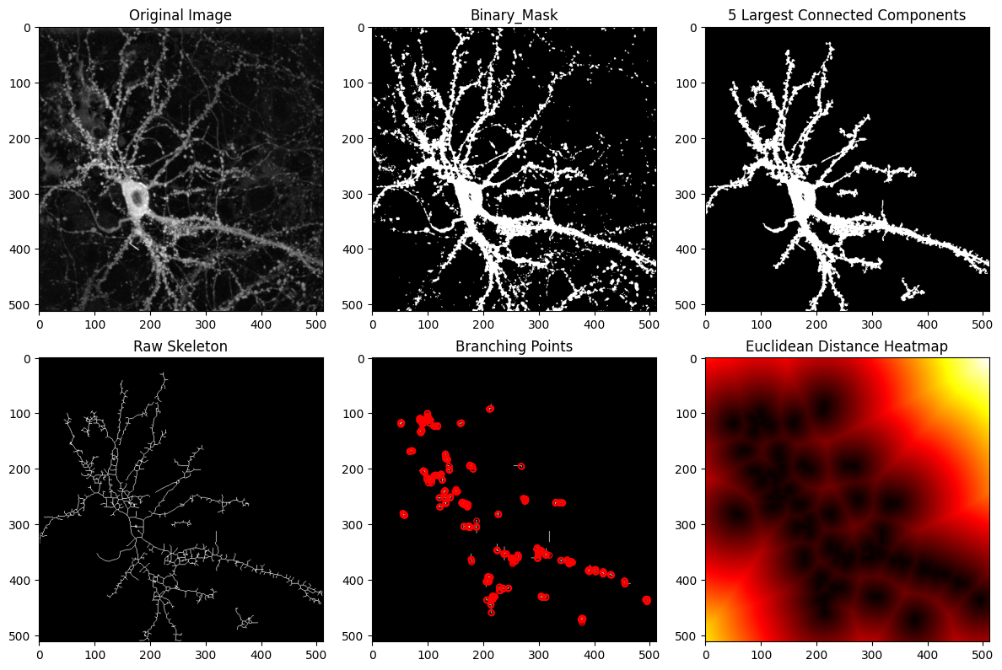
All together now

Slide 10
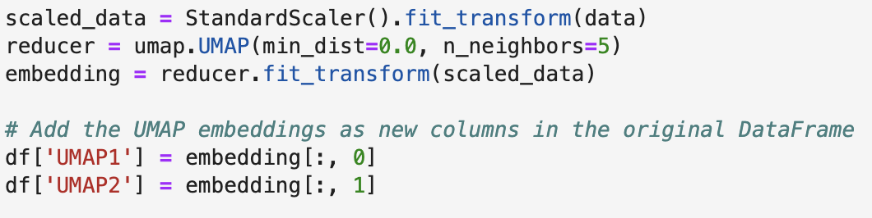
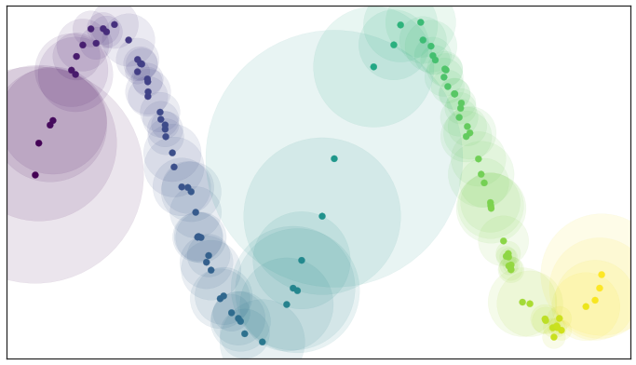
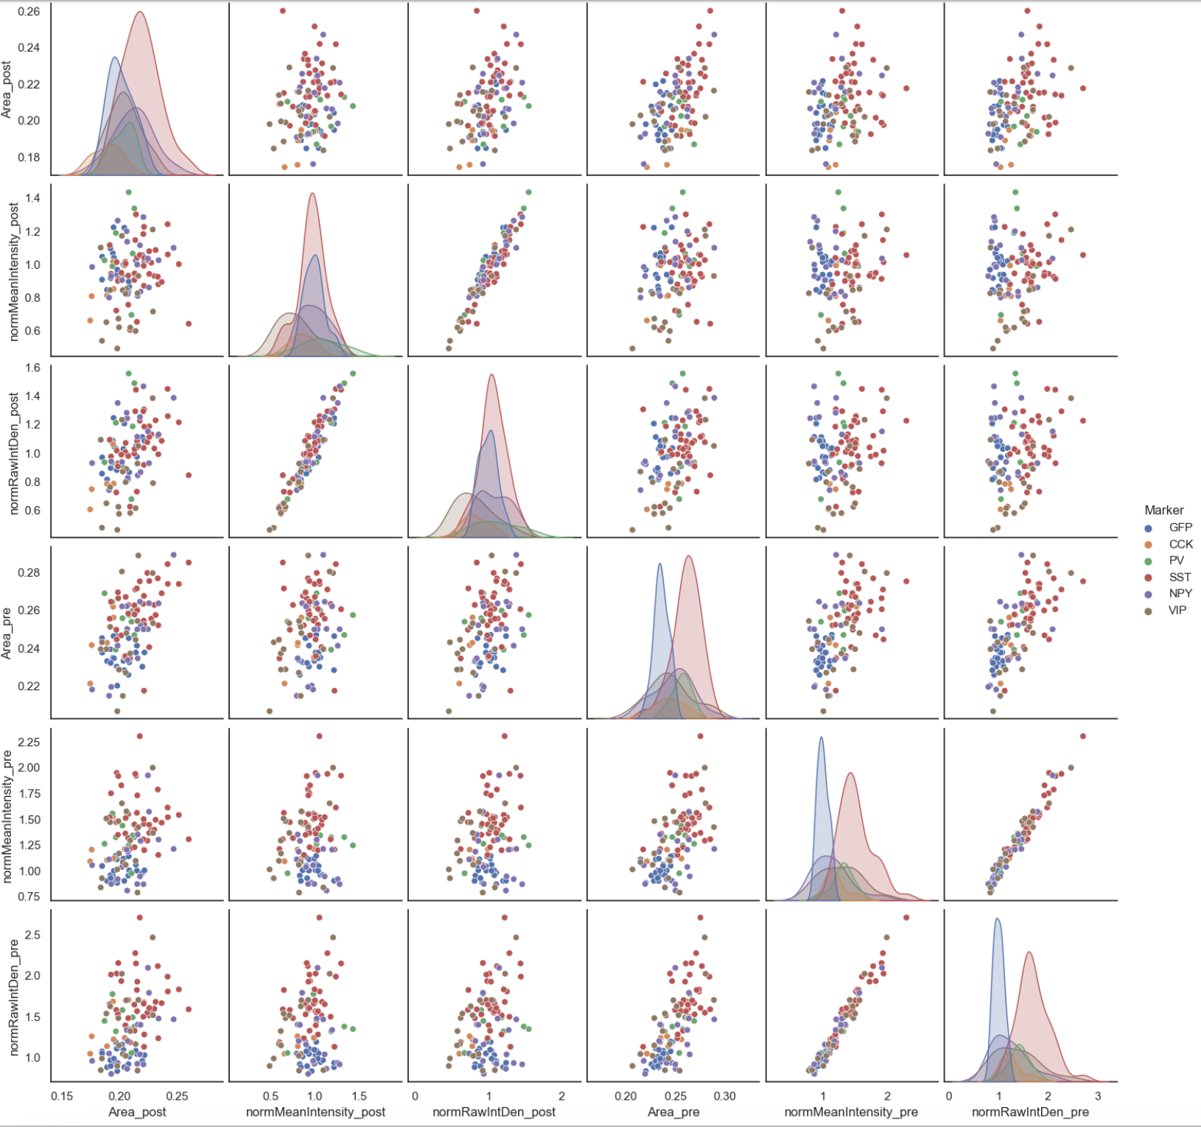
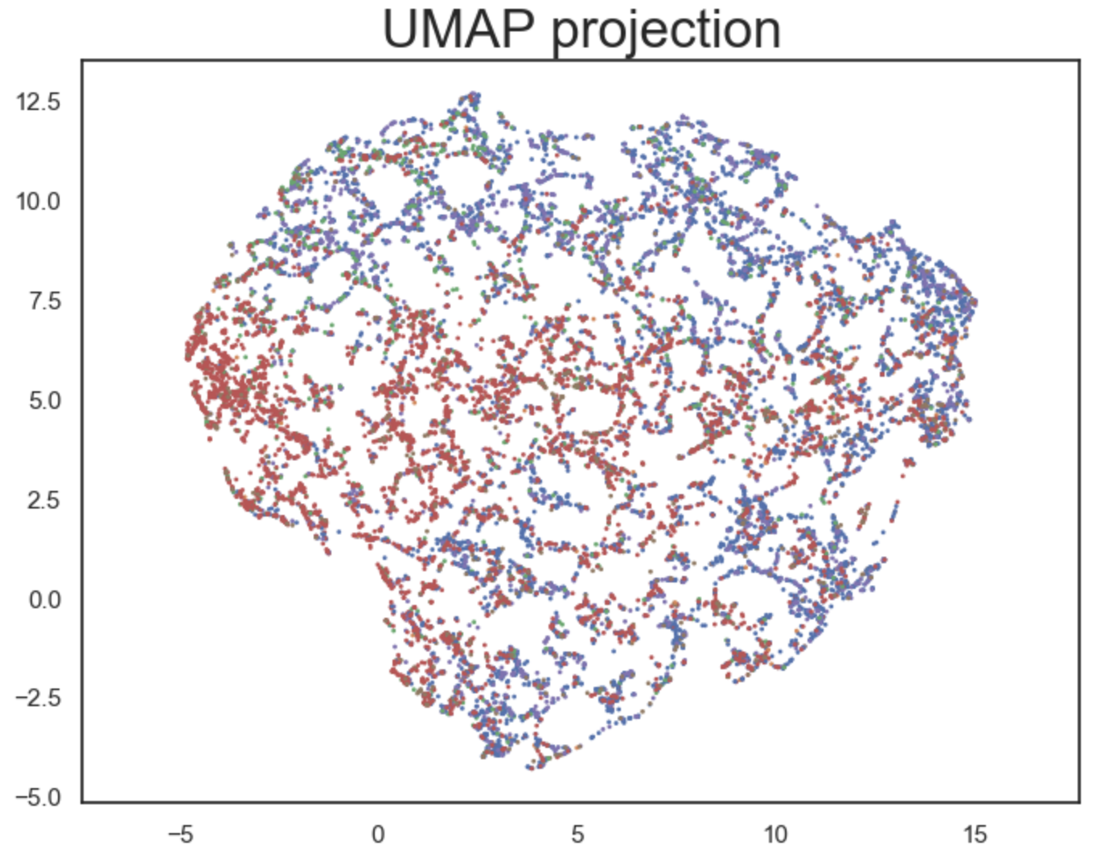
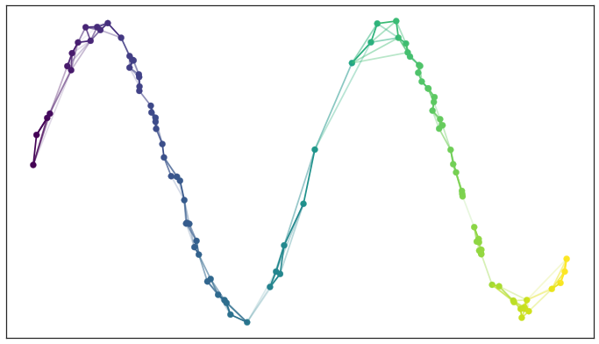
Dimensional Reduction - Uniform manifold approx + proj
Stochastic algorithm for dimension reduction based on manifold learning techniques
6 dimensions to 2 dimensions

Slide 11
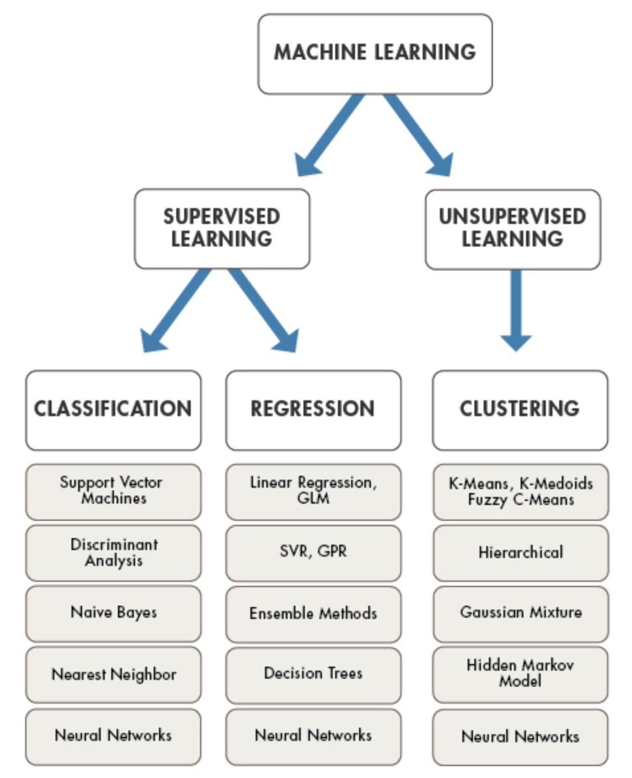
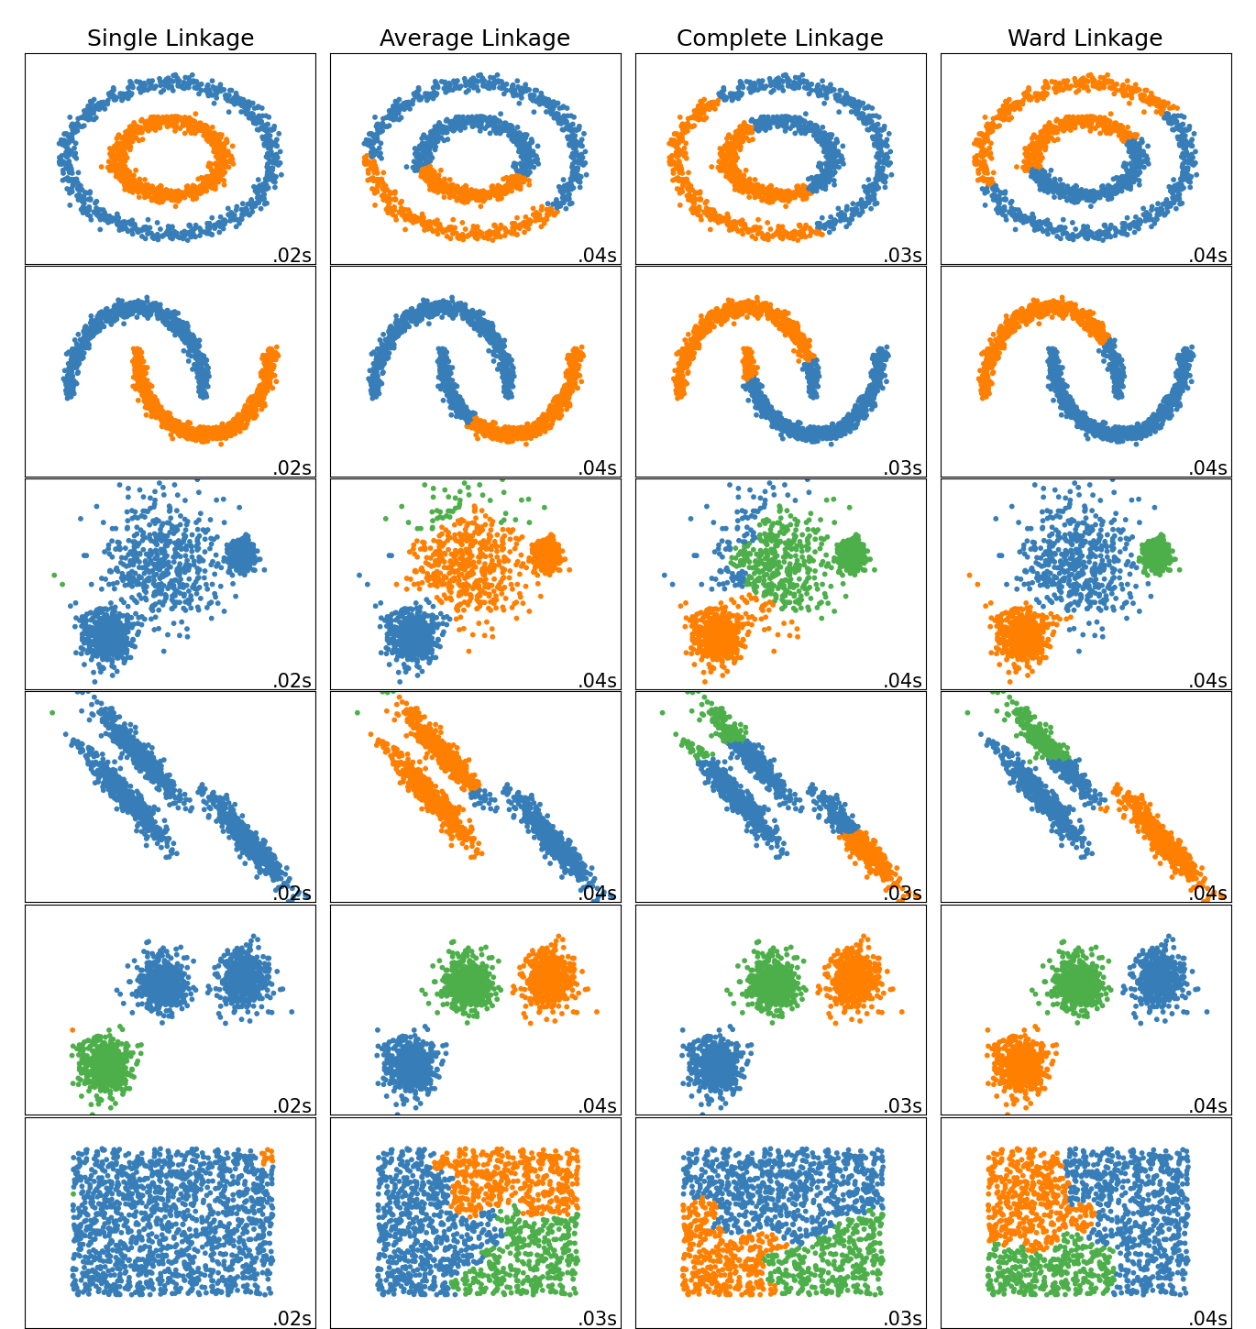
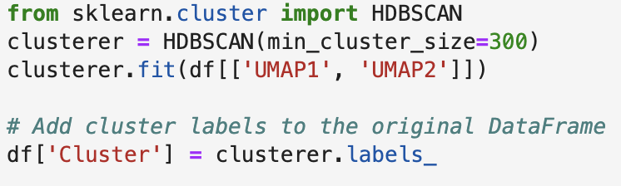
Unsupervised Learning Algorithms
Mainly measure distance and use various algorithms to group points. Different algorithms work better of some data sets than others. Also have different parameters

Slide 12
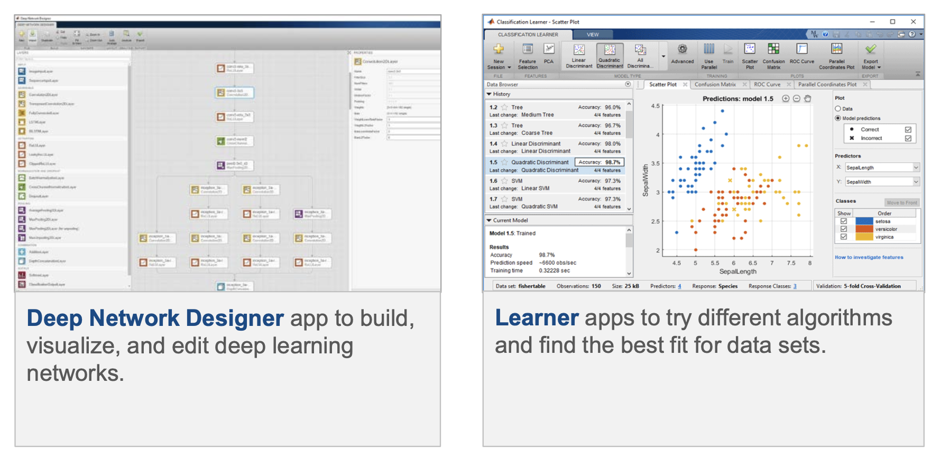
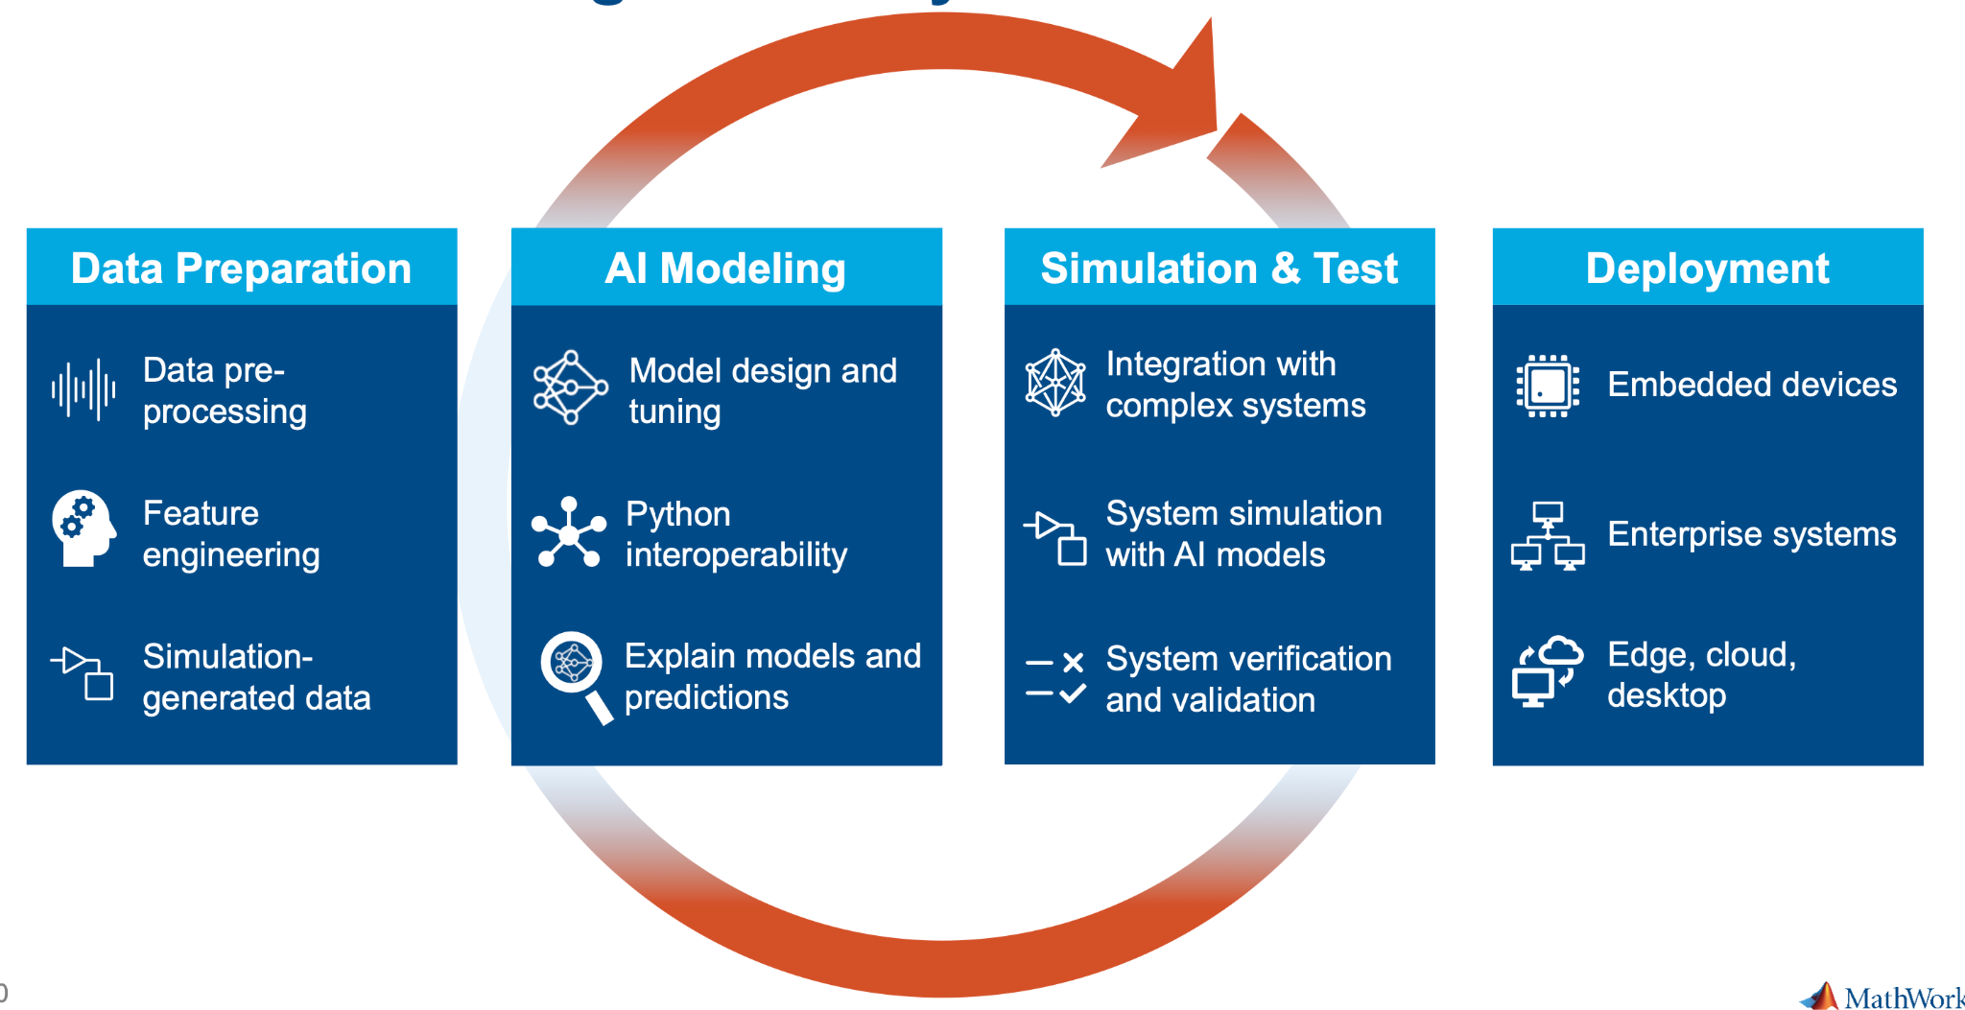
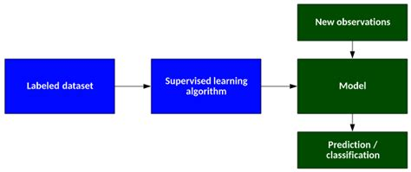
MATLAB Machine Learning and Deep Learning Toolboxes
Deep learning experiments for classification that optimize ANN parameters, interface to train models (both custom and using pretrained), feature ranking algorithms, etc.

Slide 13
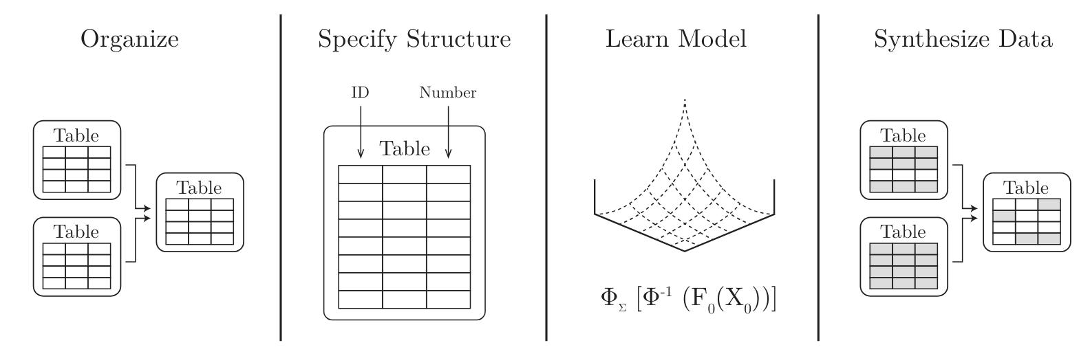
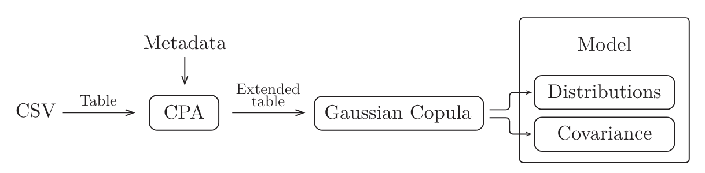
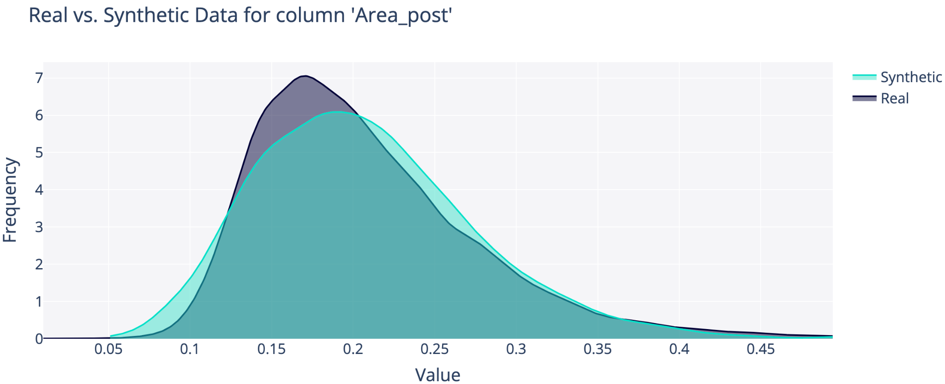
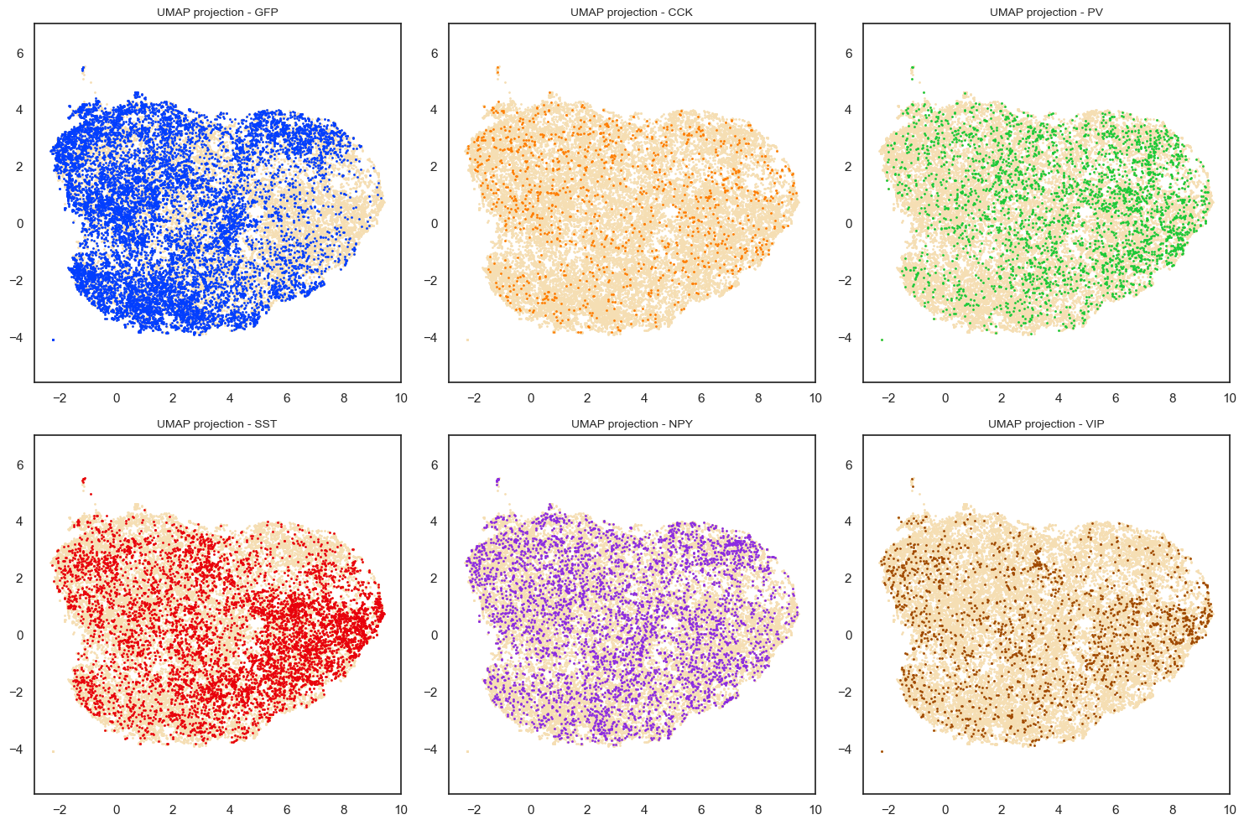
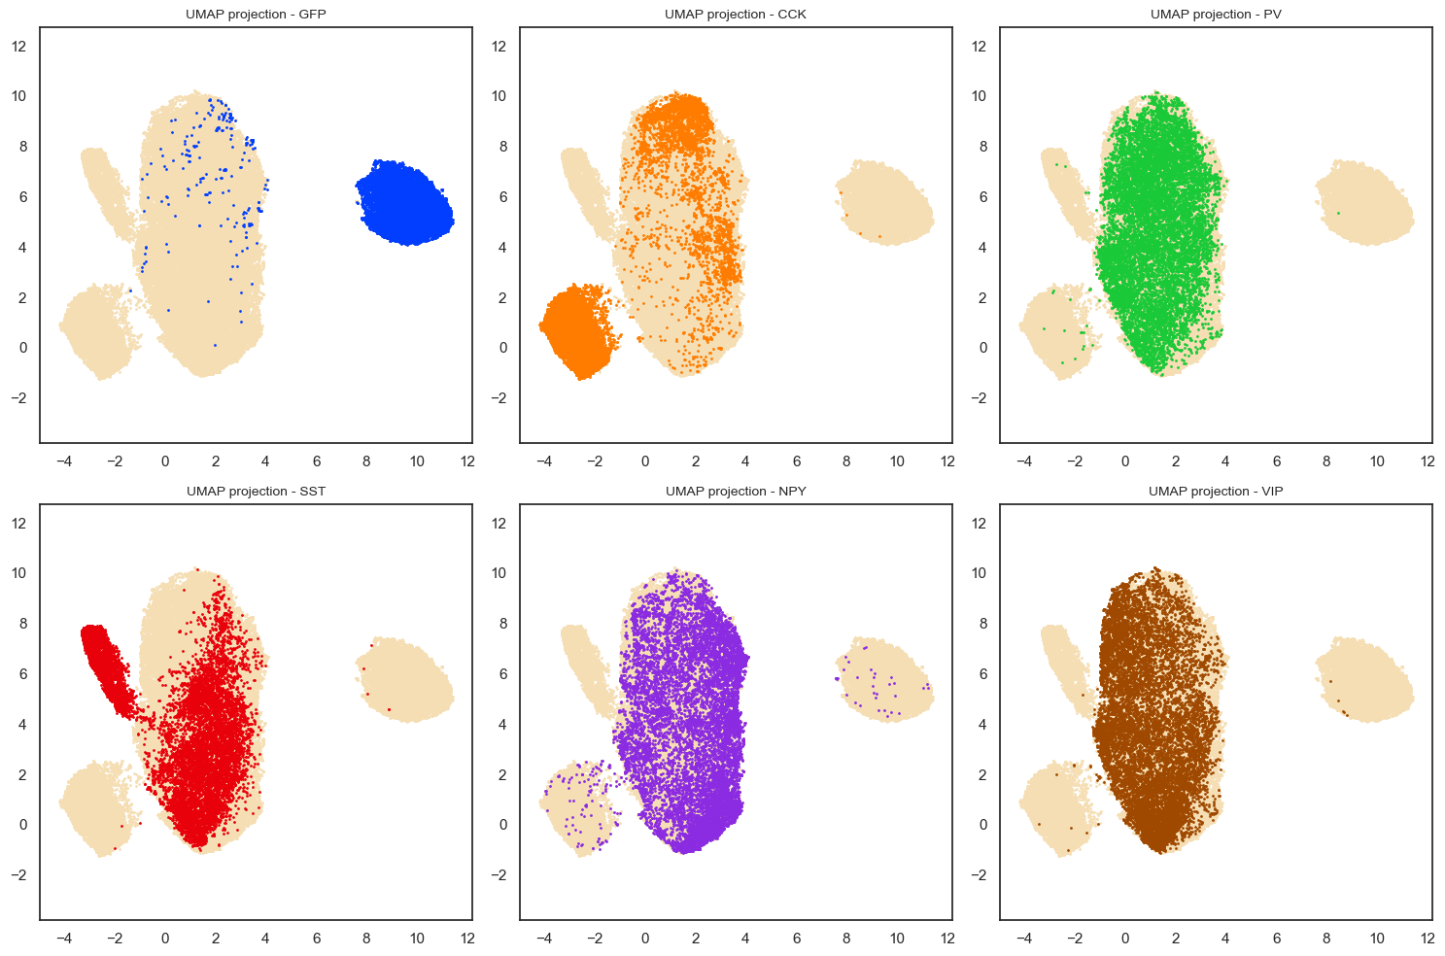
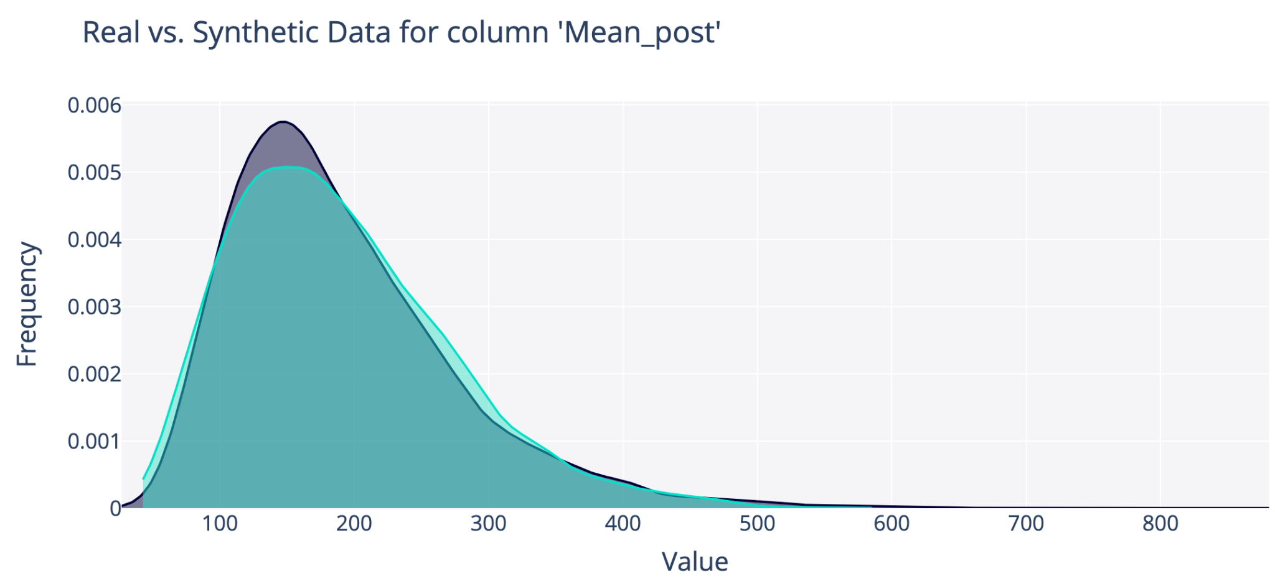
Synthetic Data Vault Python library from DataCebo
GFP
Notes:
Learns the marginal distribution to normalize the values, creating normal curves.
Learns the covariance of each pair of normalized columns. Stored as an n x n matrix

Slide 14
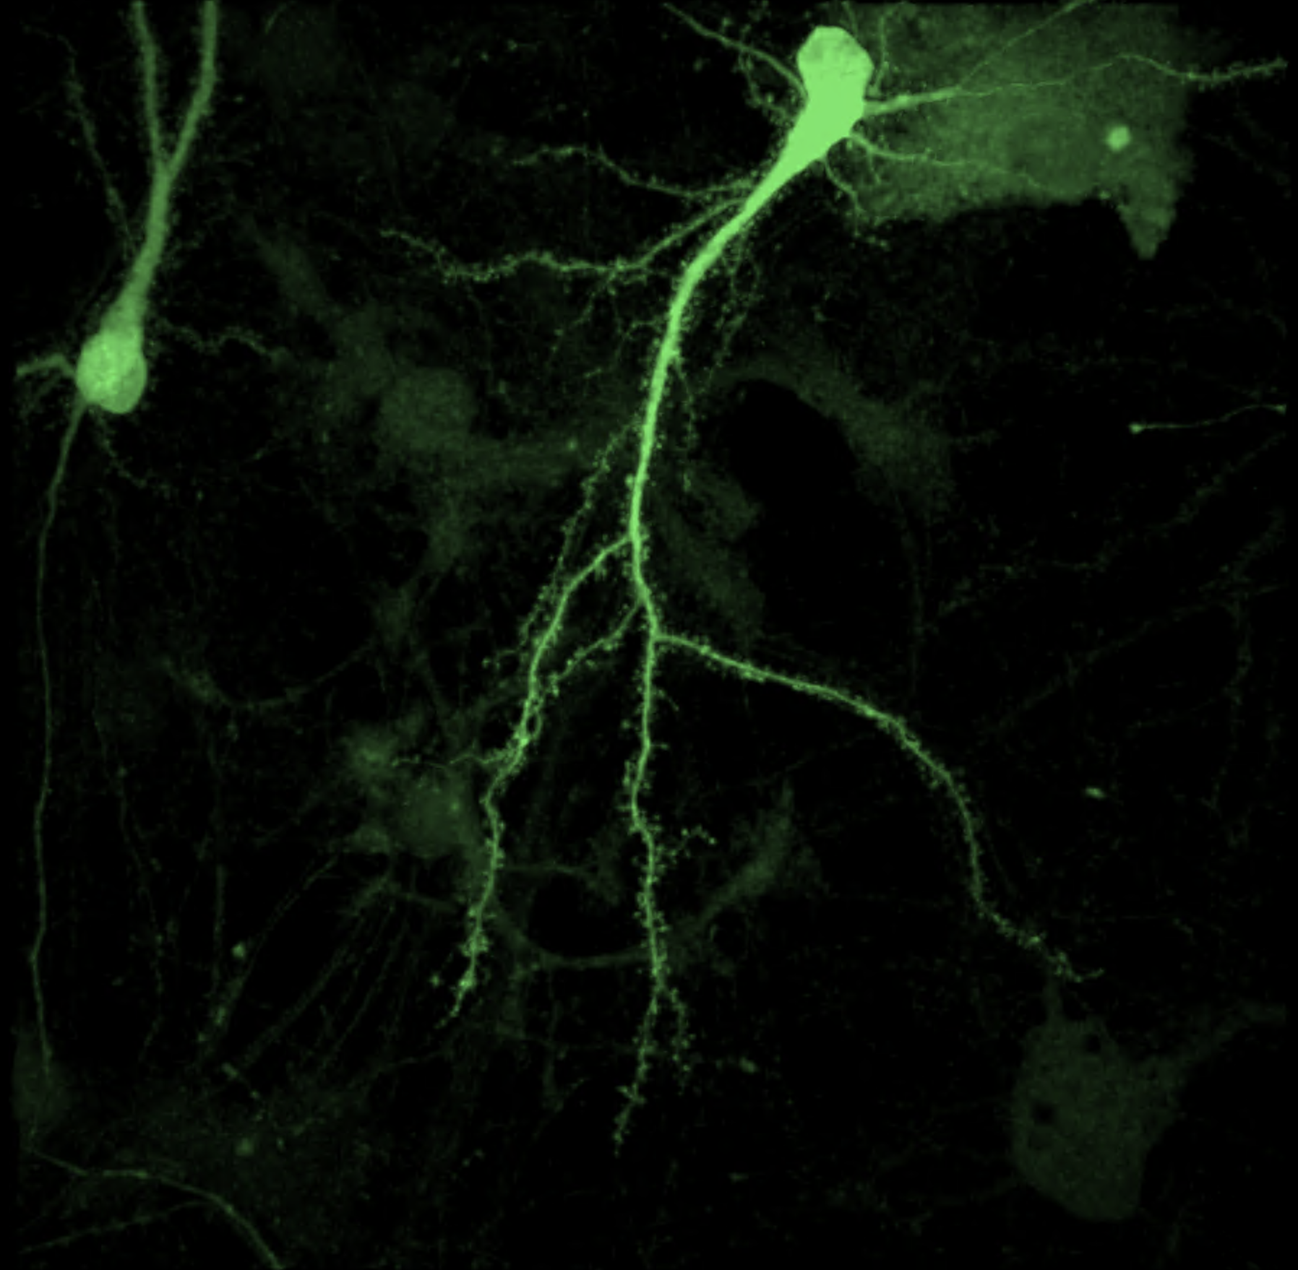
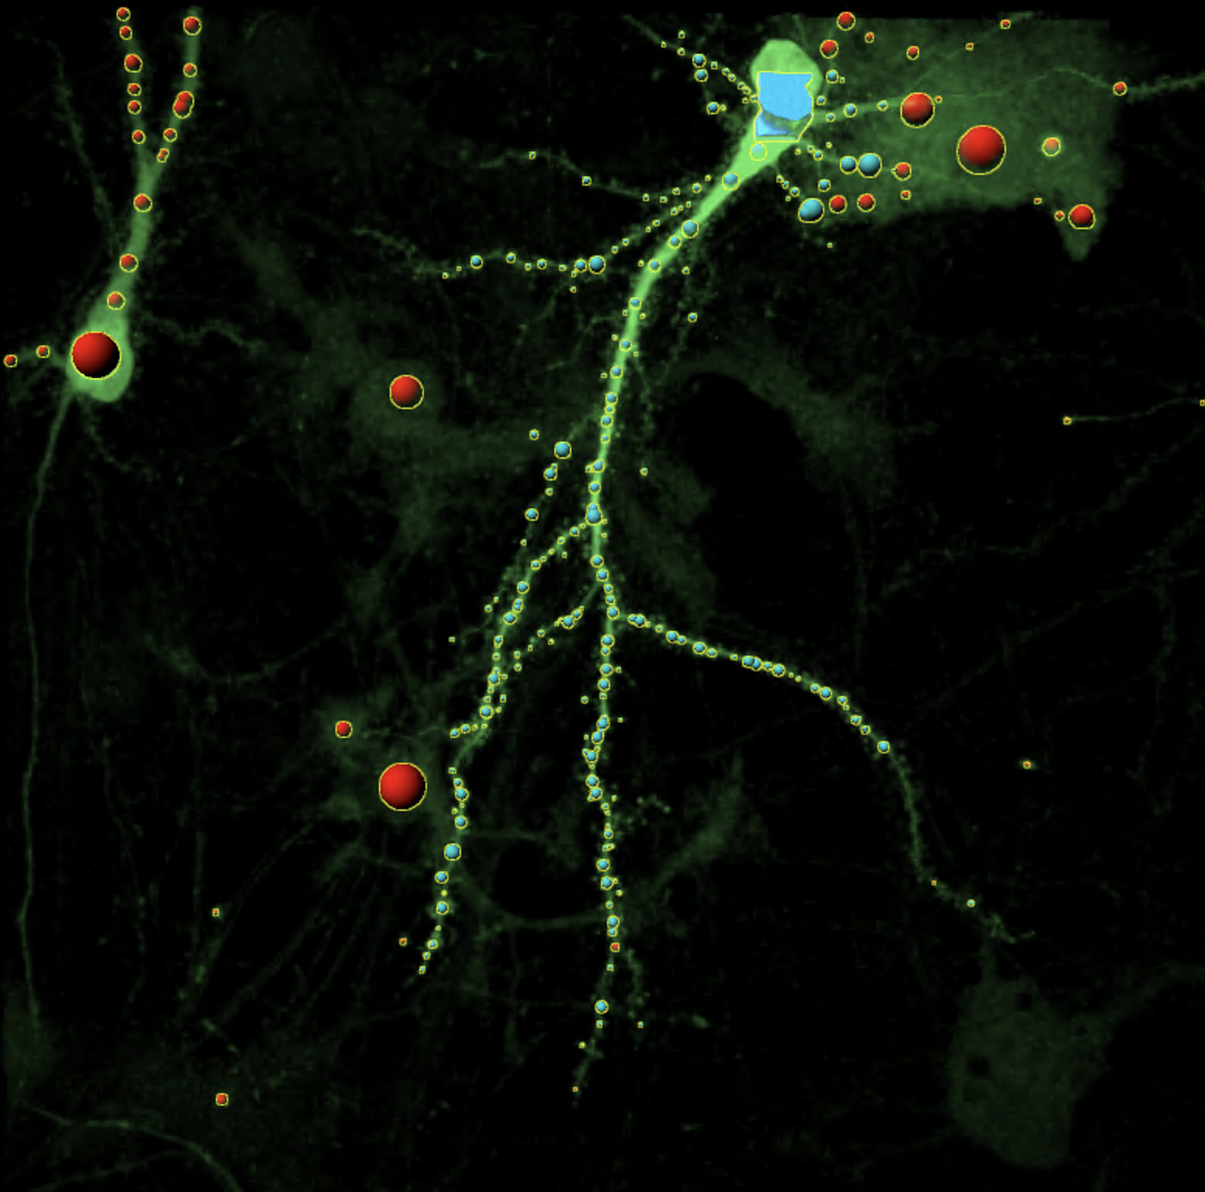
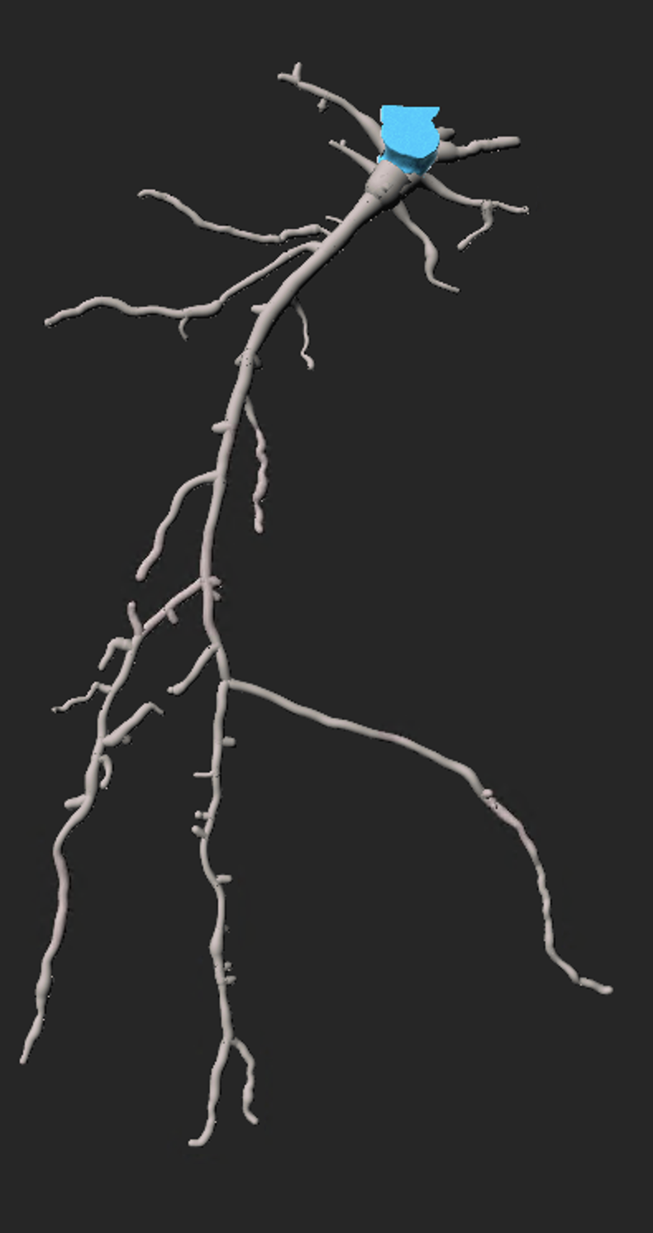
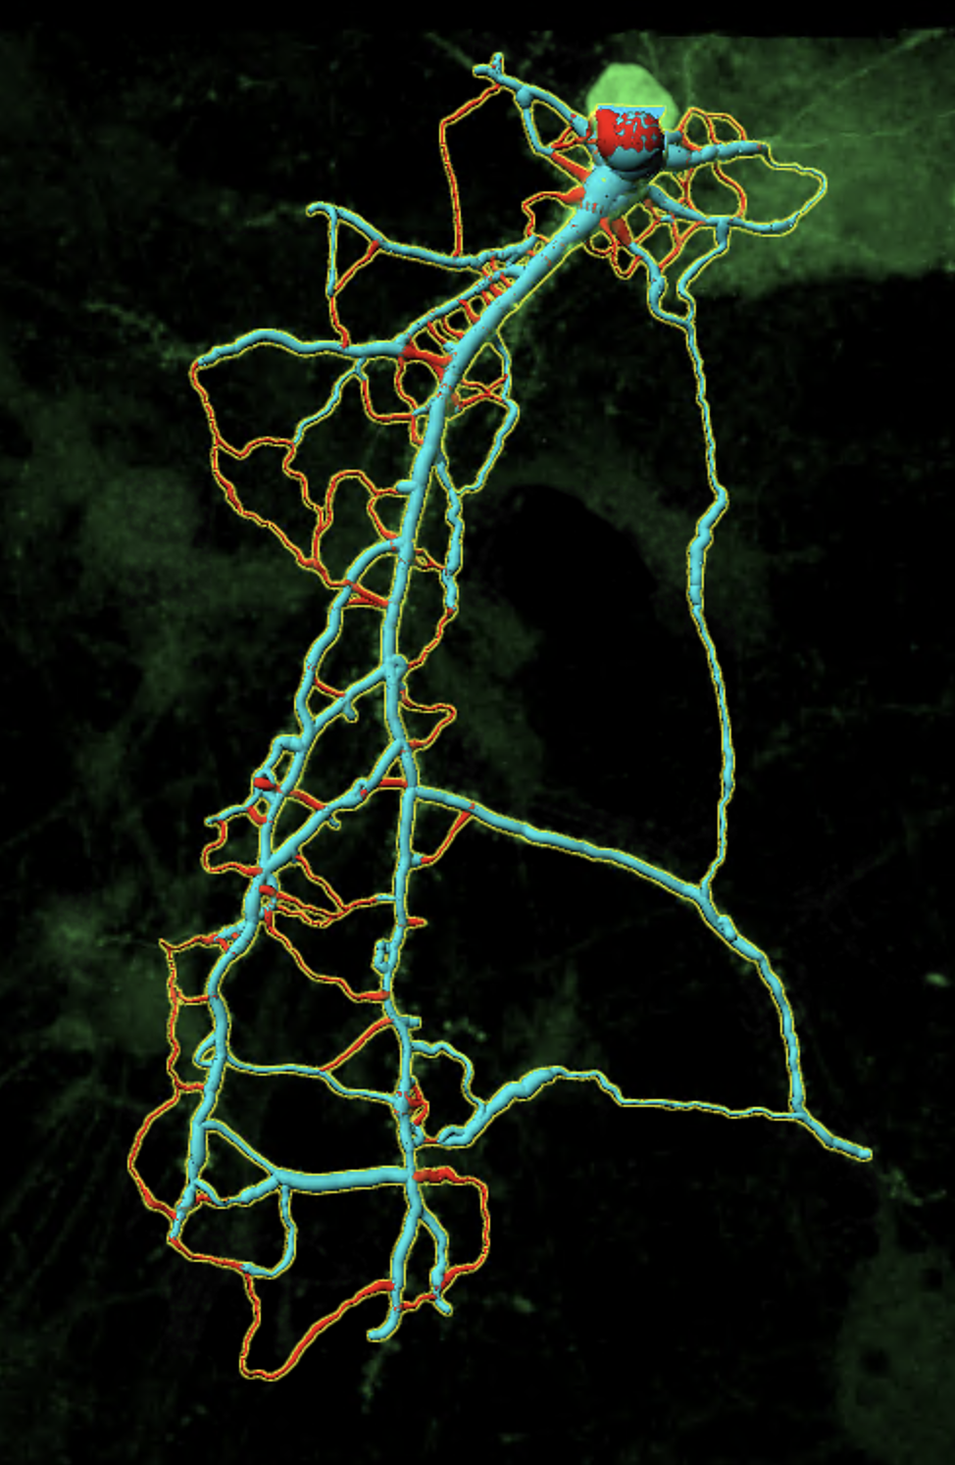
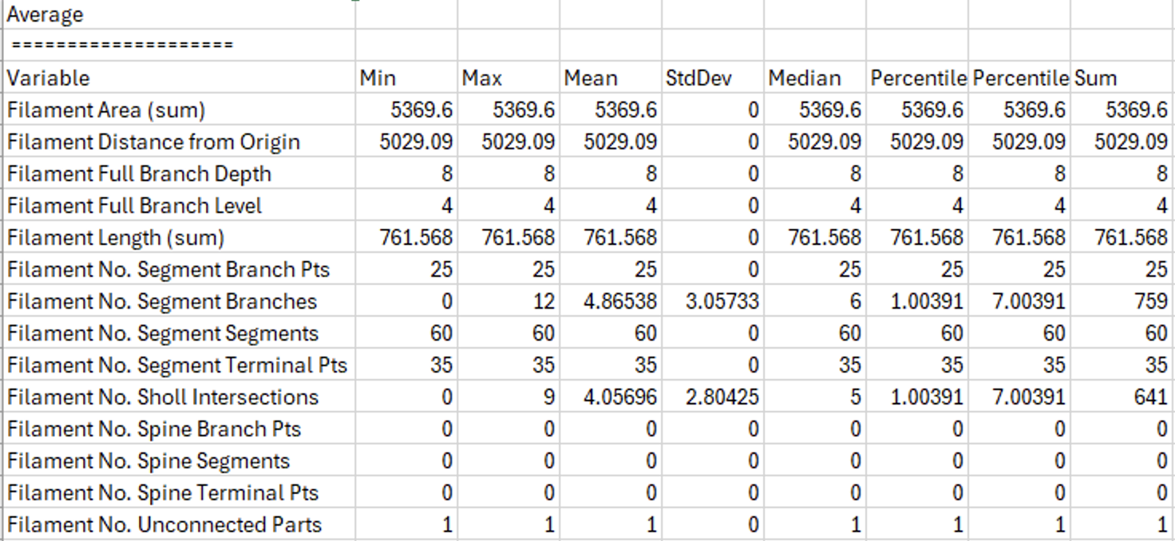
Imaris: Morphology
Process:
Preprocessing/Filtering
Filament - AI training tool
Select soma
Seed points for segments
Filter segments
Export feature averages
Correlate the morphology data of each cell to each synapse segmented from it

Slide 15
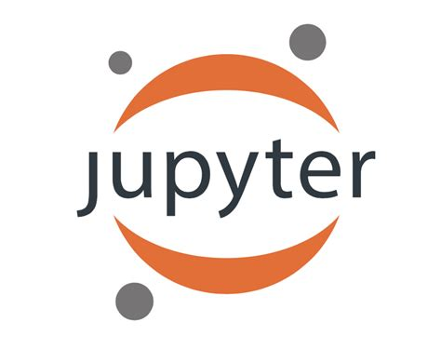

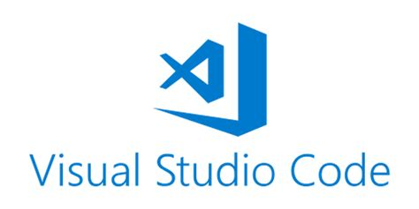

Web-based interactive development environment for notebooks, code, and data. Python, C++, SQL, etc
Hosted Jupyter Notebook service - especially well suited to machine learning and data science
Programming: IDE for python, generative AI extensions/ github co-pilot, access to GPUs
Documenting: combine text, code, images, comments, etc. in one document
Collaborating: easily share and create multiple variations of programs
Code editor that supports many languages, extensions, and platforms. Run + debug, build in Git, extensions

Slide 16
Useful Links!
https://github.com/losertlab/Python-BioImaging-Bootcamp?tab=readme-ov-file
https://letsdatascience.com/synthetic-data-generation/
https://www.nature.com/articles/s41551-021-00751-8
https://umap-learn.readthedocs.io/en/latest/basic_usage.html

